Slide 1
Agenda
01
02
03
04
05
Introduction
Topic 1
Topic 2
Next Steps
Q&A

Slide 2
Invoice OCR: GEP’s requirements
Supports file formats: TIF, GIF, PNG, JPG, JPEG, PDF
DocAI - Invoice parser will be able to support all the above formats and some more (https://cloud.google.com/document-ai/docs/file-types)
Multiple Page Support
DocAI Workbench custom splitter/classifier API will be able to split (Document splitters behavior | Document AI | Google Cloud) and classify a multi-page document Classifier
Multi-Lingual Support
OOB Invoice Parser will supports 14 languages, you add additional languages using by uptraining. You can also use translation hub which supports 200+ languages
Provides coordinates for all the attributes being extracted
Json extracted from the Doc AI - Invoice Parser provides contributes of all the attributes - here
Structured data extraction and entry from images and documents
Doc AI - Invoice Parser extracts following fields
Notes:
Extract text and values from invoices such as invoice number, supplier name, invoice amount, tax amount, invoice date, due date.
The invoice Parser extracts both header and line item fields, such as invoice number, supplier name, invoice amount, tax amount, invoice date, due date, and line item amounts.

Slide 3
Questions
Invoice OCR:
For you Invoice parsing are you using Azure Form Parser from their AI suite?
What do the microservices within the LCX Invoice OCR Composite do? Which OCR technology you are using from within the microservices?
What fields do you extract?
How many invoices you process in a given month? How many types of invoices do you process in a given month?
Are there multiple invoices in a file? Do you need to recognize and classify them?
Average number of pages in a document ?
If a particular language is not supported in GCP out of the box, have
Sample invoice documents
Queuing Service - What tool are you using for that ?
Once the Invoice extraction takes place, how do you use/ manage that data? What actions do you perform on the extracted data? E.g. keyword search, analytics, access control?
Notes:
Extract text and values from invoices such as invoice number, supplier name, invoice amount, tax amount, invoice date, due date.
The invoice Parser extracts both header and line item fields, such as invoice number, supplier name, invoice amount, tax amount, invoice date, due date, and line item amounts.

Slide 4
Invoice OCR
For Invoice OCR solution, is the Azure Form Parser the only service being used from their AI suite?
What do the microservices within the LCX Invoice OCR Composite do? Which OCR technology are you using from within the microservices?
Are all the languages shared in the prev email currently supported? If not, which ones do you currently support and which will be needed in the future ?
Are there multiple invoices in a file? Do you need to recognize each invoice individually and classify them?
How many invoices do you process in a given month? How many types of invoices do you process in a given month?
Average number of pages in a document ?
Queuing Service - What tool are you using for that ?
Once the Invoice extraction takes place, how do you use/ manage that data? What actions do you perform on the extracted data? E.g. keyword search, analytics, access control?
Would you be able to share some sample invoice documents and what fields do you want to extract from these documents?

Slide 5
Invoice OCR
For Invoice OCR solution, is the Azure Form Parser the only service being used from their AI suite? GEP: Along with Form Recognizer, we are using the raw OCR, and the text analytics SDK for language detection
What do the microservices within the LCX Invoice OCR Composite do? Which OCR technology are you using from within the microservices? GEP: Different microservices indicate different major components for the complete OCR flow, they consist of Raw OCR Extraction, Form Recognizer Extraction, Master Data Validation, Duplicate Invoice Detection, Language Detection etc.
Are all the languages shared in the previous email currently supported? If not, which ones do you currently support and which will be needed in the future? GEP: All the languages shared in the previous email are currently supported. In addition, we are planning to integrate Indonesian Bahasa Language as well by September 2023.
Would you be able to share some sample invoice documents and what fields do you want to extract from these documents? GEP: Please refer to the Invoices_sample_set.zip and the attached excel.

Slide 6
Invoice OCR
Are there multiple invoices in a file? Do you need to recognize each invoice individually and classify them? GEP: Yes, there can be multiple invoices in a file which need to be recognized individually.
How many invoices do you process in a given month? How many types of invoices do you process in a given month? GEP: Invoices volume can range from 4000-8000 invoices per day.
Average number of pages in a document ? GEP: Average no of pages is around 2-3 only but we are planning to support max pages up to 50 pages.
Once the Invoice extraction takes place, how do you use/ manage that data? What actions do you perform on the extracted data? E.g., keyword search, analytics, access control? GEP: The AI services only focus on extraction of data followed by a check against the Master data. Access Control is being managed by the application team rendering the values on the UI.
Would you be able to share some sample invoice documents and what fields do you want to extract from these documents? GEP: Please refer to the Invoices_sample_set.zip and the attached excel.

Slide 7
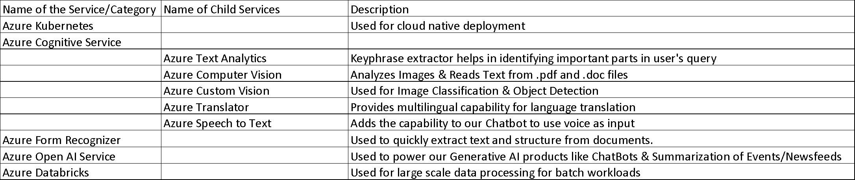
Notes:
Azure Text Analytics - Natural Language AI
Azure Computer Vision - Vision AI
Azure Custom Vision - Vision AI*
Azure Translator - Translation AI
Azure Speech to Text - Speech to Text
Azure Form Recognizer - Doc AI
Azure Open AI - Vertex AI/PaLM Models
Azure Databricks - Dataproc

Slide 8
Questions
Contract Metadata Extraction -
What fields do you intend to extract
Type of documents ?
Rule based extractor - are there different rules for different documents ?
Data Volumes
Sample documents used for custom vision
Overall Question: Is this all part of an application ? How is this workflow/use case getting triggered ? Have we spoken to them about migrating that application ?
Contract Text Extraction -
What fields do you intend to extract
Confirming: DocX Extractor - custom Python code ?
Data Volumes
Sample documents used for Computer vision and custom vision - Both PDF and DOCX

Slide 9
Agenda
Introduction
Discovery based on shared information
DocAI Invoice + Demo (uptraining)
DocAI Workbench (custom contracts extractor)
DocAI Warehouse Demo (OCR + LLLM search)
Next Steps
Q&A

Slide 10
GEP Language requirements
Invoice OCR
Contracts
English
Spanish
Dutch
German
Italian
French
Czech
Danish
Polish
Swedish
Portuguese
LATAM SPANISH
Chinese Simplified
Chinese Traditional
Japanese
Korean
Norwegian
English
French
German
Portuguese
Chinese
Spanish

